Slide 1


EXTRACTING AND CLEANING INCIDENT & WORK ORDER SYSTEM
(E-CIWOS)
User Guides
Muhammad Fakrullah bin Latif
August 2024

Slide 2






Table of Content
INTRO-
DUCTION
PROCESS
FLOW
HOW TO
EXPORT
DISCLAIMER
OVERVIEW OF SYSTEM
HOW TO
EXTRACT
HOW TO
CLEAN

Slide 3



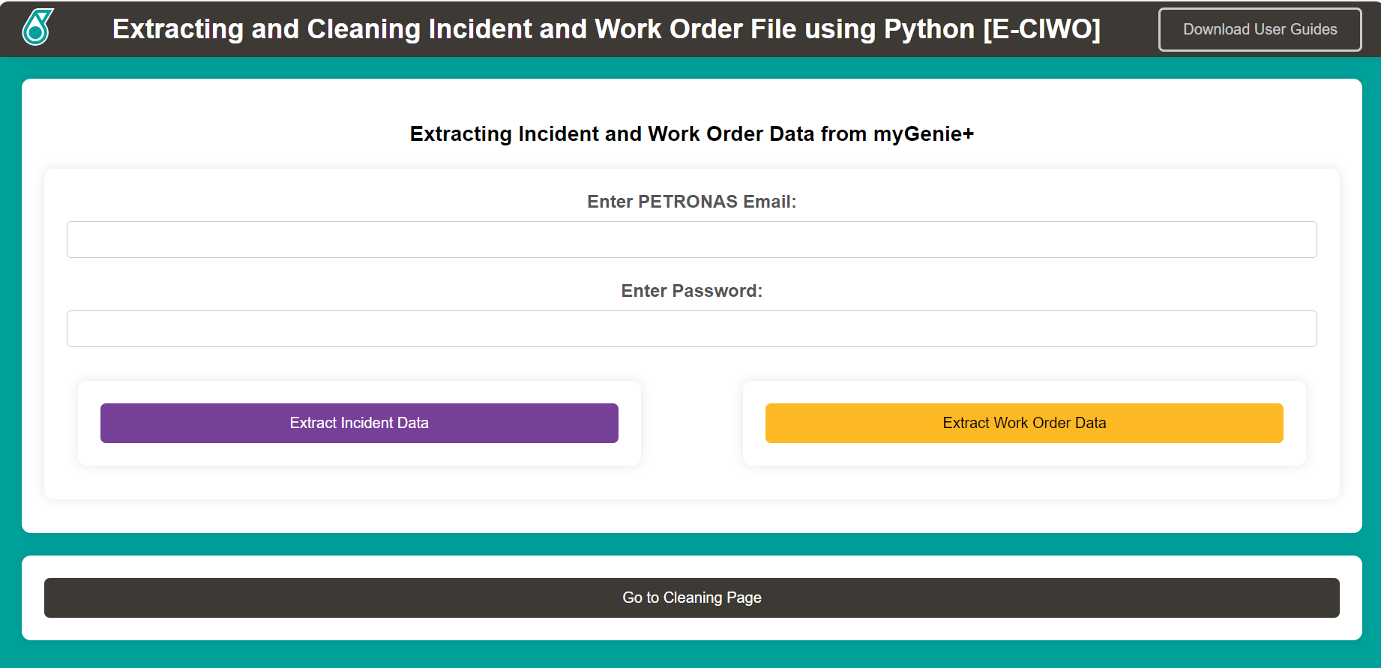
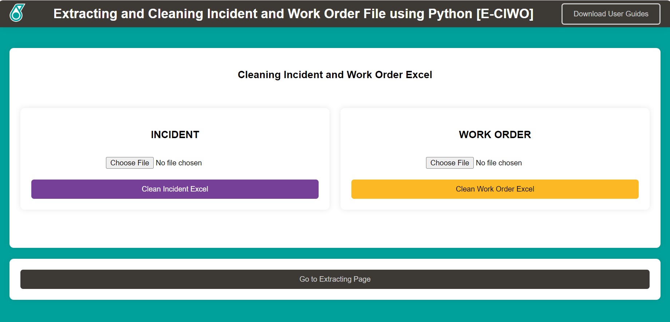

OVERVIEW OF SYSTEM
Extracting and Cleaning Incident and Work Order System (E-CIWOS)
E-CIWOS is python derived web application designed to automate the preparation of reports into dashboard.
Target User: My supervisor, Noor Aziah.
Platform: Flask (Python derived web application) that can run through local computer.

Slide 4
USER ACCESS MODULE
Pre-Requisite
Download Chrome Application: https://www.google.com/chrome/
Download Chrome Web Driver win64 version: https://googlechromelabs.github.io/chrome-for-testing/
Download Visual Studio Code: https://code.visualstudio.com/download
Download Python: https://www.python.org/downloads/
Guides of using virtual environment: https://saturncloud.io/blog/how-to-set-up-virtual-environments-in-visual-studio-code-for-jupyter-notebooks/
Install Selenium: pip install selenium
Install Pandas: pip install pandas
Install Flask: pip install flask

Slide 5
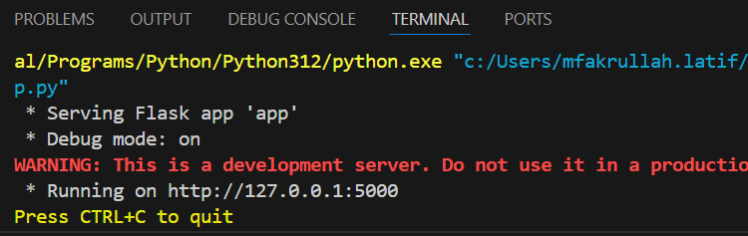
USER ACCESS MODULE
How to Access
The system is run locally in personal laptop. Therefore, using Visual Studio Code to run the application code to get local IP.
After running, the terminal is shown the IP, we only need to copy the link into the browser.

Slide 6


PROCESS FLOW OF EXTRACTION
1
2
3
4
5
START
1. Run Application
2. Enter PETRONAS email and password
3. Validate by Microsoft Authenticator
4. Monitor Progress Bar
5. Automatically download the outcome
Yes
Wrong input?
No
No
No
Give correct code?
Yes
Yes
Stuck or error appeared?
No
No
Found file in download?
Yes
END

Slide 7
PROCESS FLOW OF CLEANING
1
2
3
4
START
1. Run Application
2. Upload Incident or Work Order excel
3. Click the button
4. Check Downloaded file in Download
Yes
Wrong format (.xlsx)?
No
No
Yes
Error appeared?
No
No
Found file in Download?
Yes
END

Slide 8
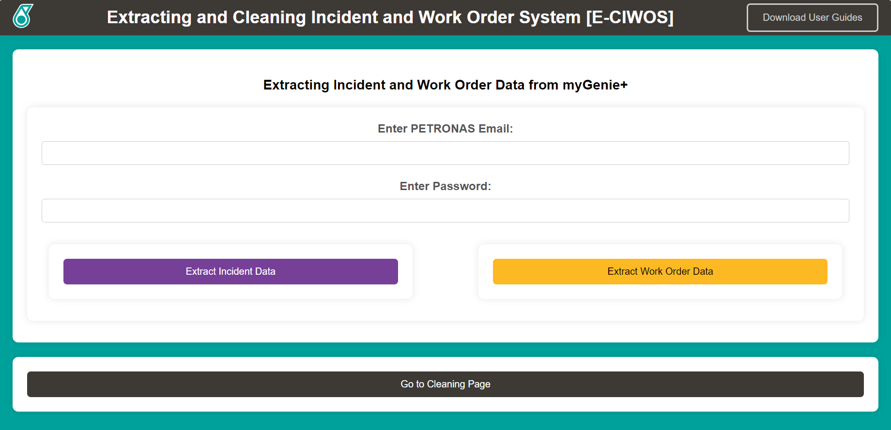
USER ACCESS MODULE
How to Extract
Run the application.
Once in the landing page, user will see Extracting Pages.
Insert PETRONAS Email and password to proceed.
[Make sure the user is already registered inside myGenie+.]

Slide 9
USER ACCESS MODULE
How to Extract
Click ‘Extract Incident Data’ to extract Incident Report from myGenie+.
Click ‘Extract Work Order Data’ to extract Work Order Report from myGenie+.
OR

Slide 10
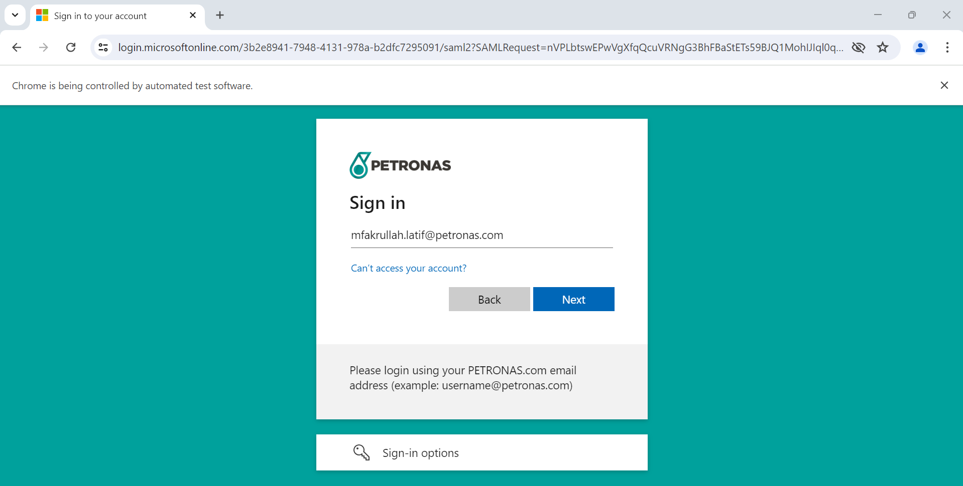
USER ACCESS MODULE
How to Extract
The website is brought to Google Chrome where the automation is started.

Slide 11
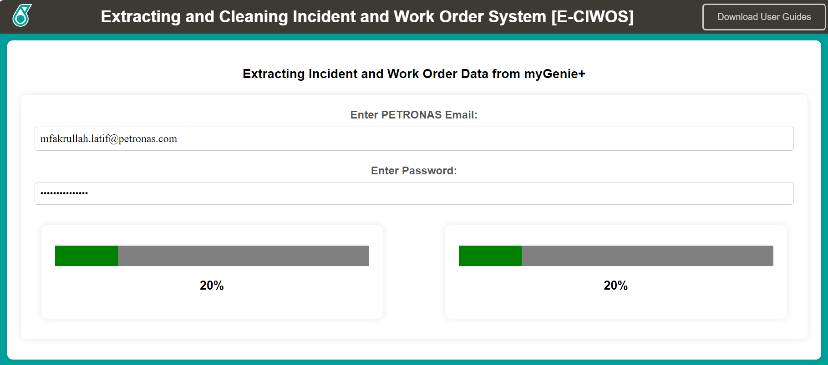
USER ACCESS MODULE
How to Extract
User can monitor the progress through progress bar on the web page.

Slide 12
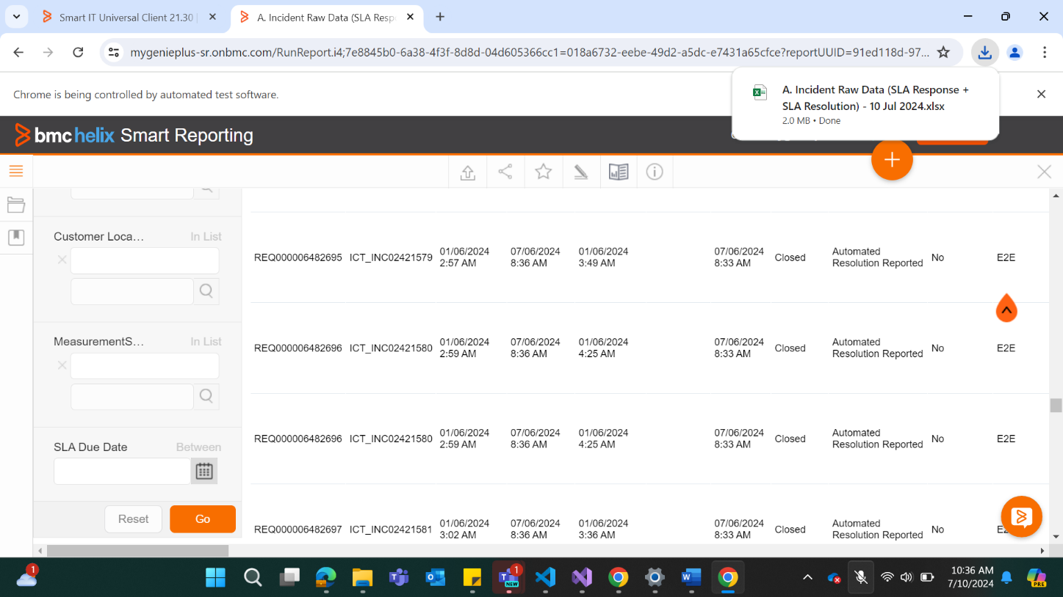
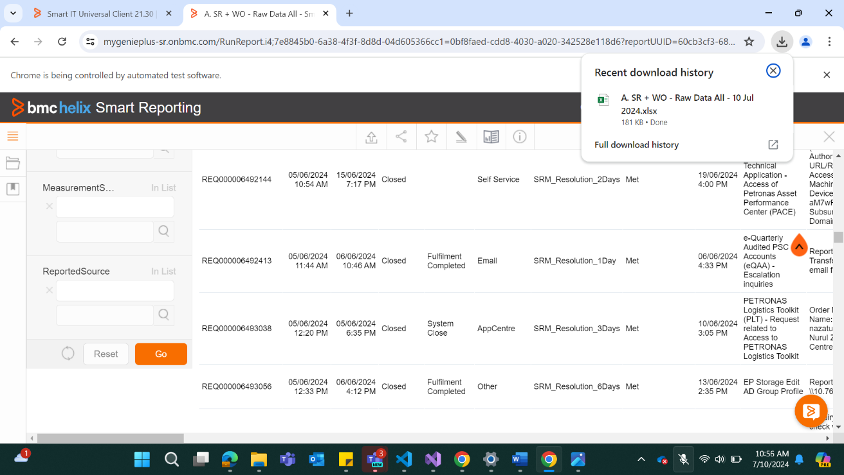
USER ACCESS MODULE
How to Extract
7. Once the file downloaded, the process finished and completed.

Slide 13
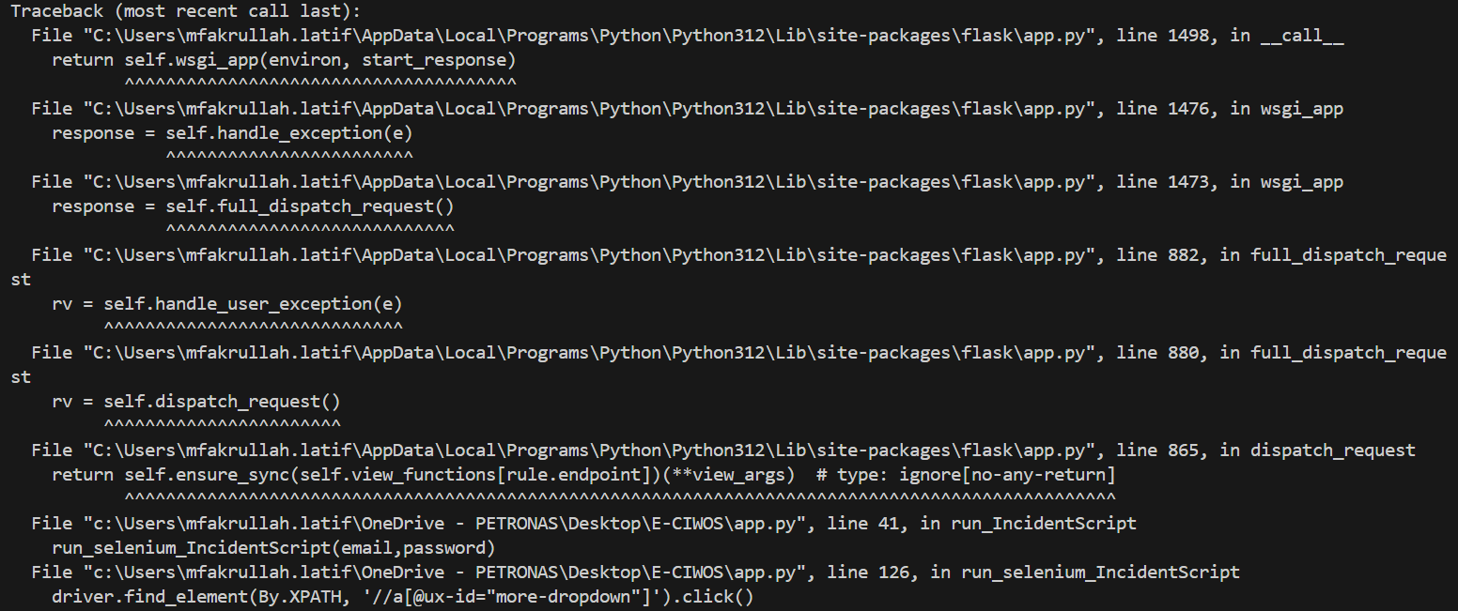
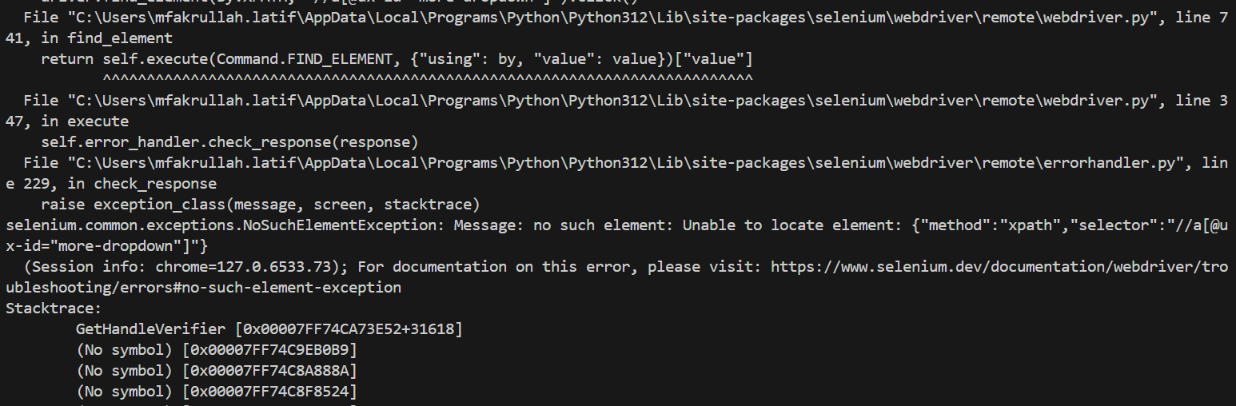
USER ACCESS MODULE
WARNING #1 : Unable to locate element
Solution #1
1. If found this error, user need to adjust “ID” of the element.
Solution #2
1. If found this error, user need to adjust “TIME” of execution.

Slide 14
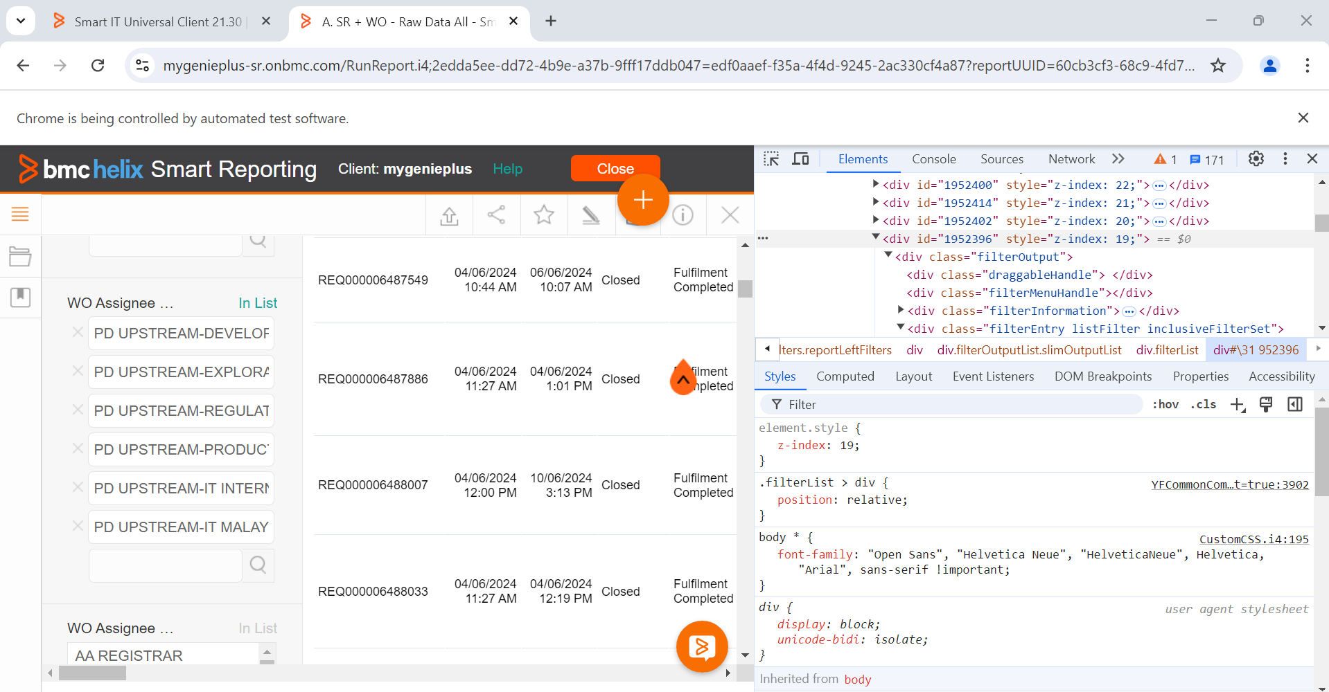
USER ACCESS MODULE
SOLUTION #1 : Adjust ID of the element
The problem usually occurred on this page, where id of the element is frequently changing due to security purpose.
To overcome it, user need to inspect the elements and get the id.
The situations are stated below.
Getting WO Assignee (for Work Order report)
Getting Date (for Work Order Report)
Getting Product (for Incident Report)
Getting Date (for Incident Report)

Slide 15



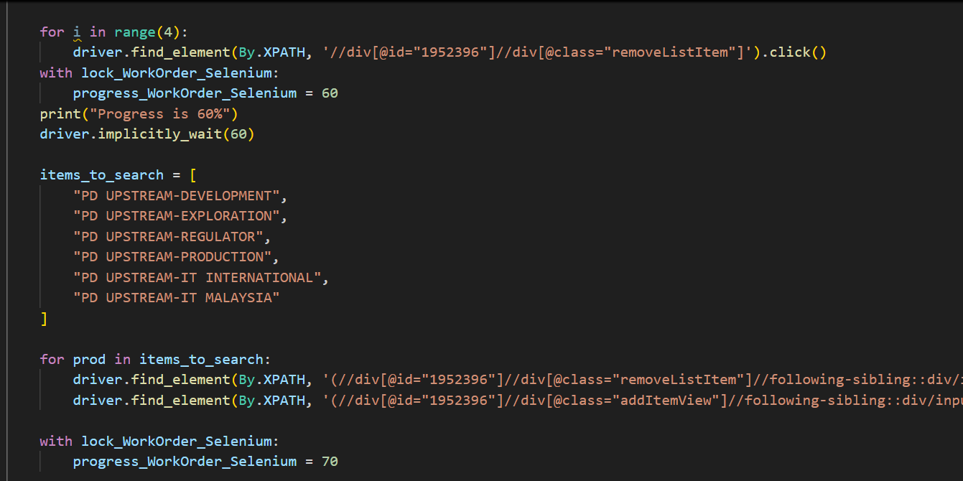
USER ACCESS MODULE
SOLUTION #1 : Adjust ID of the element
Situation 1: Getting
WO Assignee
Inspect WO Assignee elements.
Get the id.
Copy the id inside their respective code.
Run the application again.

Slide 16
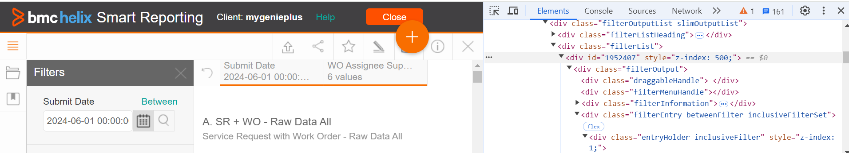
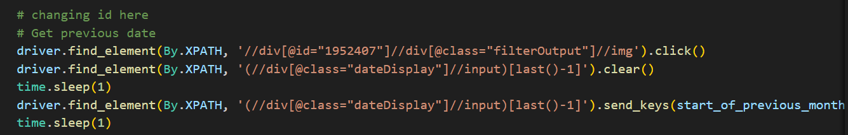
USER ACCESS MODULE
SOLUTION #1 : Adjust ID of the element
Situation 2: Getting Date
(for Work Order Report)
Inspect Calendar elements.
Get the id.
Copy the id inside their respective code.
Run the application again.

Slide 17
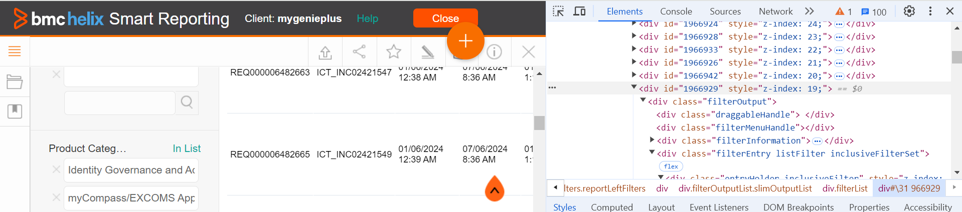
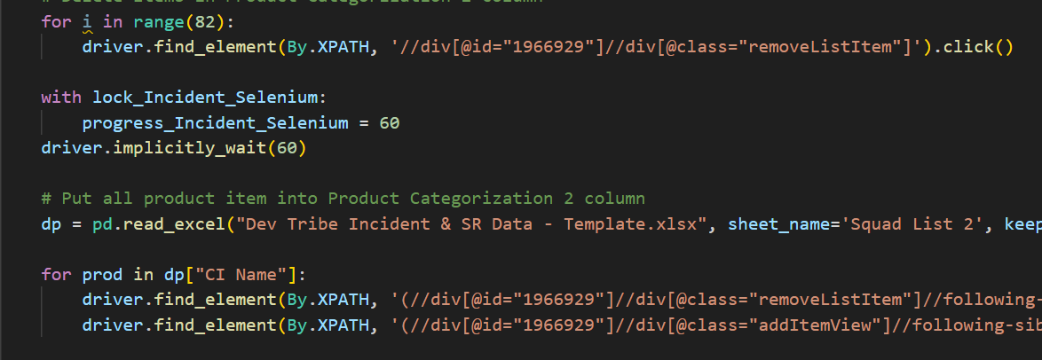
USER ACCESS MODULE
SOLUTION #1 : Adjust ID of the element
Situation 3: Getting Product
Categorization 2
Inspect Product Categorization 2 elements.
Get the id.
Copy the id inside their respective code.
Run the application again.

Slide 18
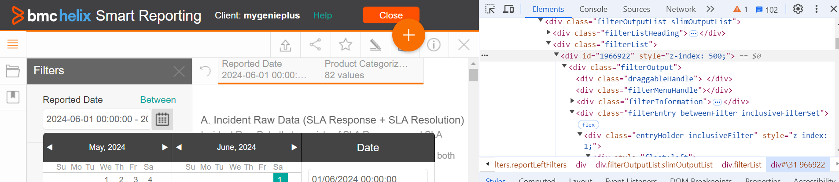
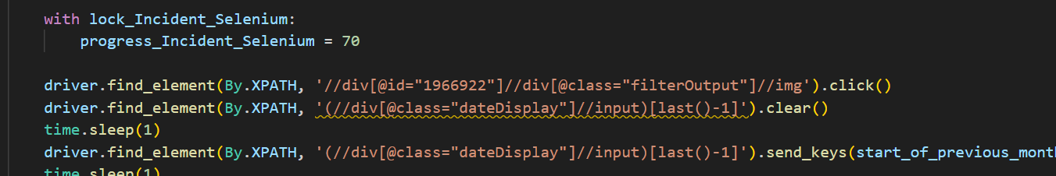
USER ACCESS MODULE
SOLUTION #1 : Adjust ID of the element
Situation 2: Getting Date
(for Incident Report)
Inspect Calendar elements.
Get the id.
Copy the id inside their respective code.
Run the application again.

Slide 19
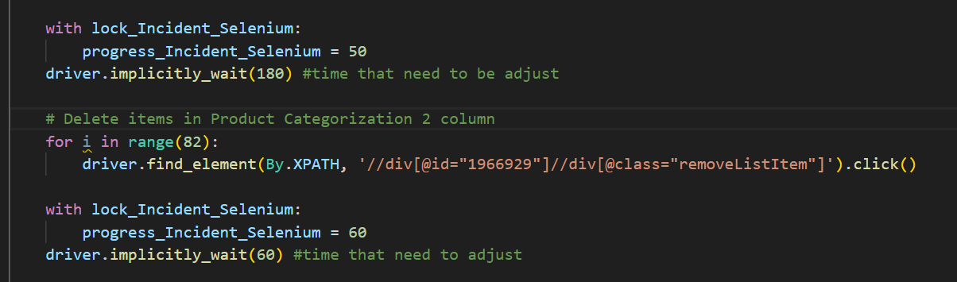
USER ACCESS MODULE
SOLUTION #2 : Adjust TIME
The problem originated when time to process and load is not enough.
I already trying my best to setup the time so, the timing is optimal
If the error happen due to timing, please add the time of processing the actions.
The are examples time that most probably need to be updated time to time.

Slide 20
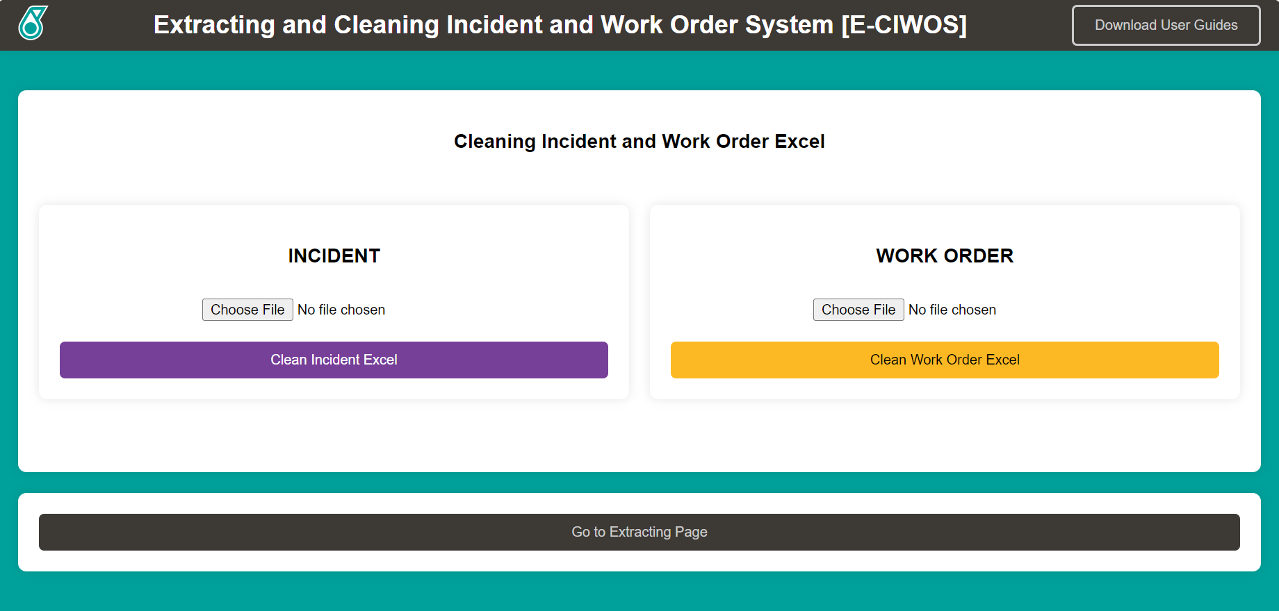
USER ACCESS MODULE
How to Clean
Run the application.
Once in the landing page, user will see Cleaning Pages.
The page divided into two parts, Incident and Work Order.

Slide 21
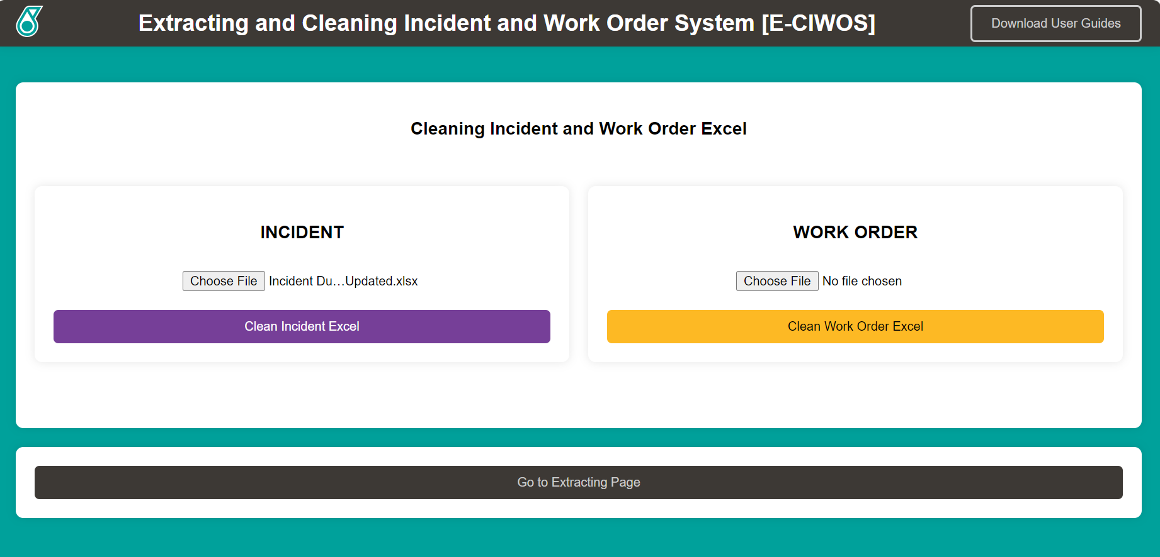
USER ACCESS MODULE
How to Clean
Upload Incident Report into Incident Column to clean Incident Report.
Click ‘Clean Incident Excel’.
Upload Work Order Report into Work Order Column to clean Work Order Report.
Click ‘Clean Work Order Excel’.
[The buttons will disable after clicking]
OR

Slide 22
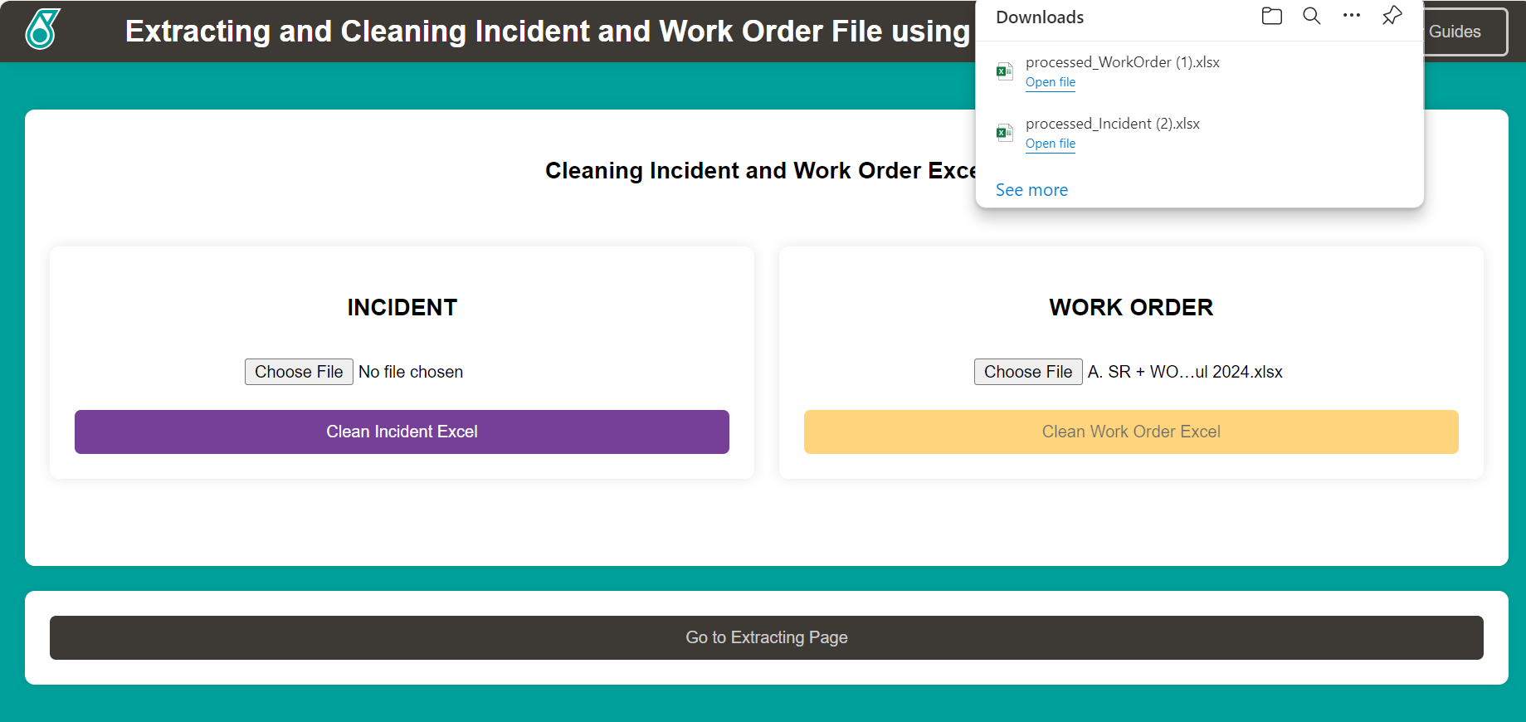
USER ACCESS MODULE
How to Clean
Once the file downloaded, the process finished and completed.

Slide 23
USER ACCESS MODULE
WARNING #2 : Can’t open Excel File
Solution #1
1. Close any related excels.

Slide 24
USER ACCESS MODULE
How to Export
1. Open the processed incident and workorder excel file.
2. Copy and compile all the data into Compiled Excel Incident and Work Order from previous years.
3. Copy all formulas inside the excel to avoid error.
4. Replace the new updated excel file into Power BI Dashboard.

Slide 25
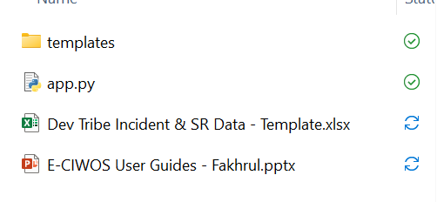
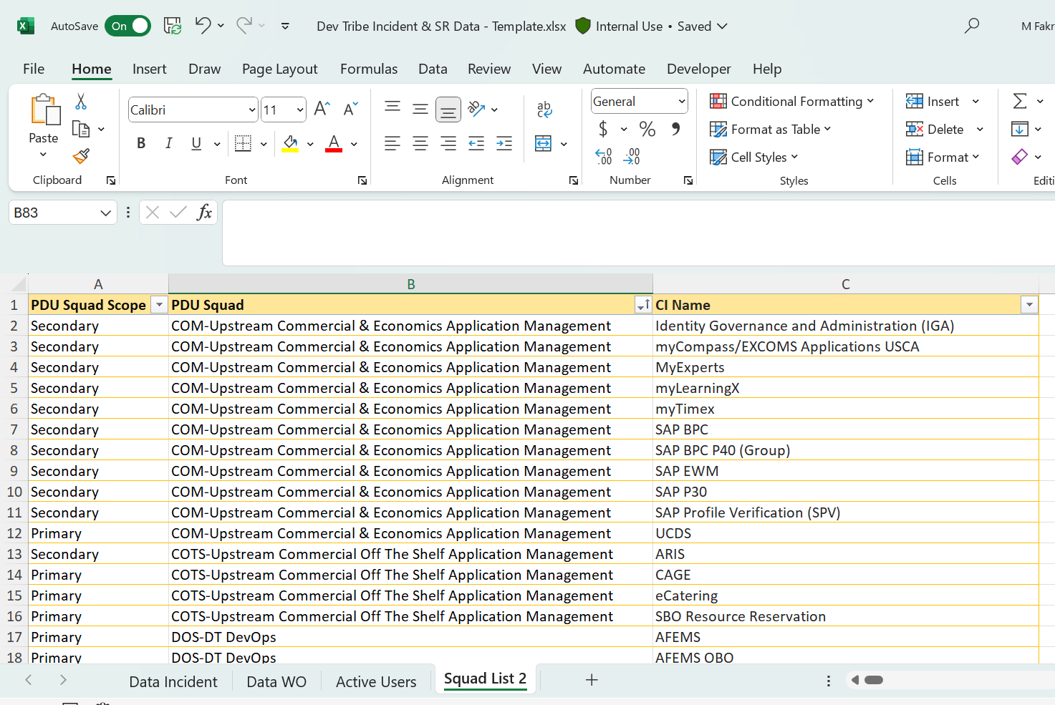
USER ACCESS MODULE
SITUATION #1: Want to add/update products
Open E-CIWOS Application
folder.
Add new item inside table in Squad List 2.
Make sure to add the product is same name that
inside myGenie+ application.
[Disclaimer: It is because the template file is already connected with the code]

